Slide 1
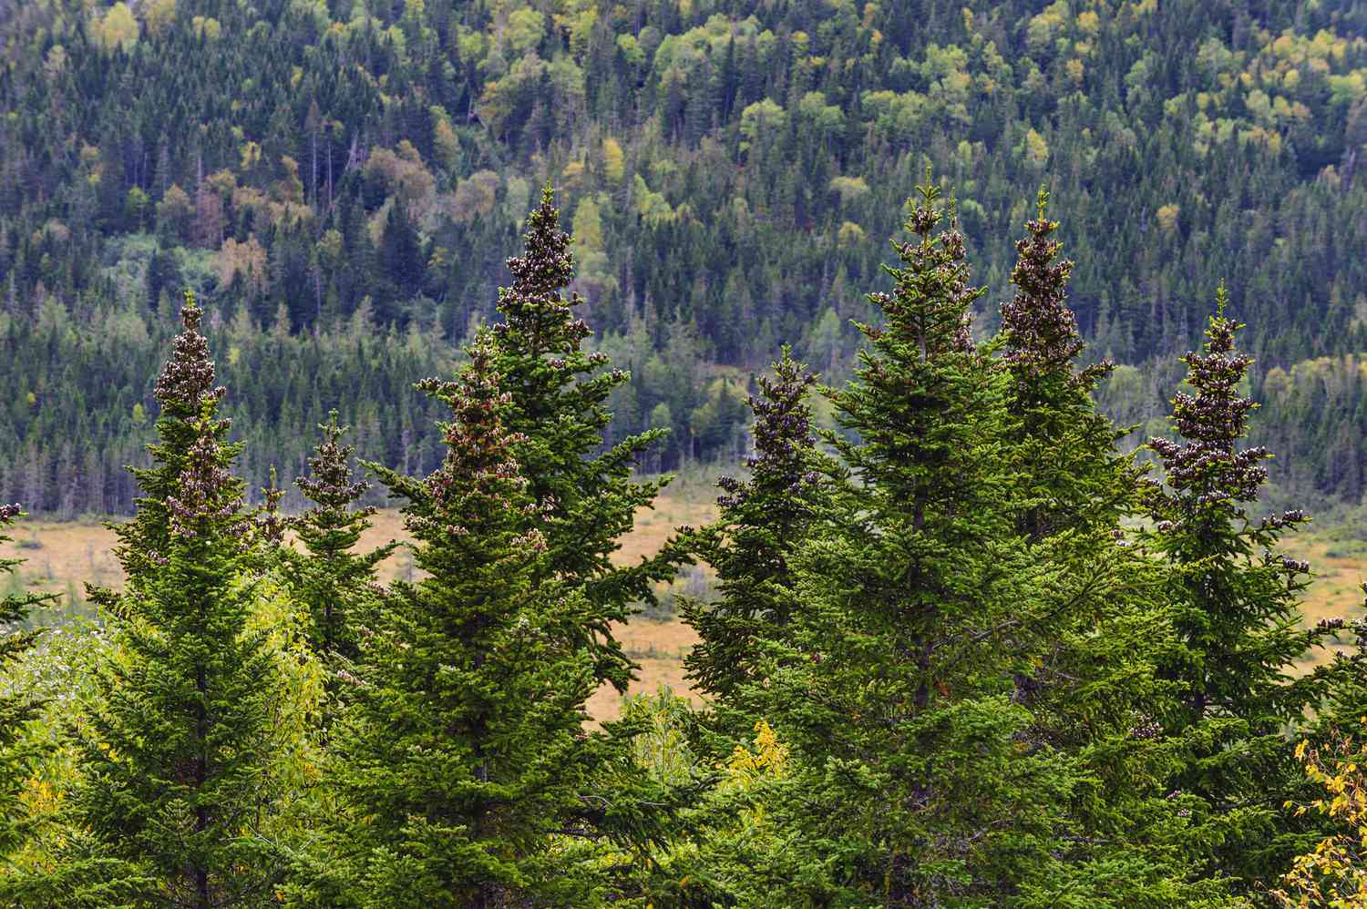
FOREST COVER TYPE PREDICTION
BY-
Bhavya Bhalla (102103345)
Shivansh Gupta (102103321)

Slide 2
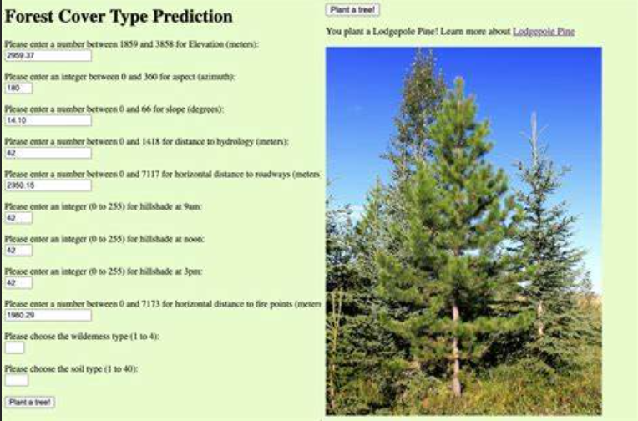
INTRODUCTION
The "Forest Cover Type Prediction" project is an exciting endeavor in the field of machine learning and environmental research. This project involves tackling a multi-class classification problem, where the goal is to determine the specific forest cover type of a given area based on a variety of environmental and geographical features.
Importance: Land management,
conservation, and ecological studies.

Slide 3
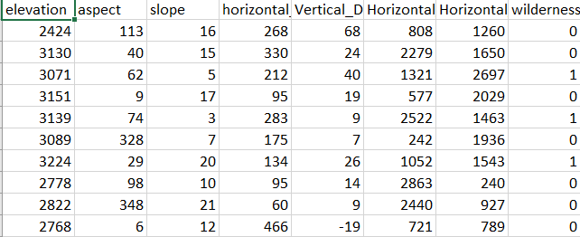
DATASET DESCRIPTION
The dataset which we are using is a tabular dataset used for forest cover type prediction. Each column represents a specific feature, and the last column ("class") indicates the target variable/ column, which is the forest cover type.
Features:
Elevation, Aspect, Slope, Horizontal/Vertical Distance to Hydrology.
Distance to Roadways, Fire Points, Wilderness Areas, Soil Types.
Target Variable: Forest Cover Type (Multi-class classification).
Role of Features:
Explanation of how each feature influences forest cover types.

Slide 4
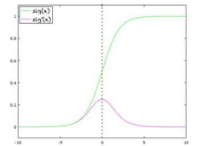
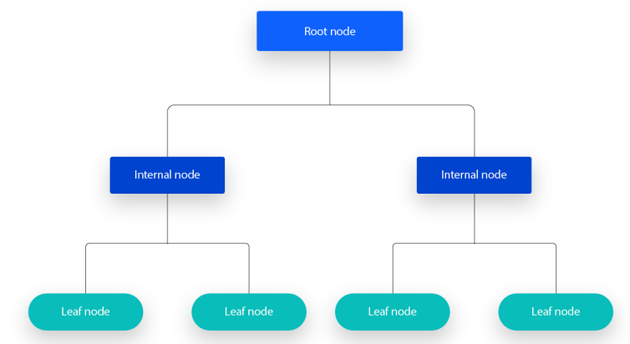
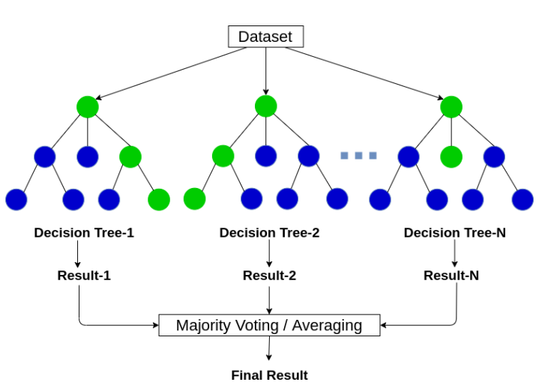
METHODOLOGY
Steps:
Importing Libraries: pandas, numpy, scikit-learn, matplotlib, imbalanced-learn, seaborn.
Data Exploration: Identify features, check for missing values, examine class distribution.
Data Visualization: Plot curves to show feature distribution.
Data Scaling: Standardize data for uniform impact on models.
Class Imbalance Handling: Use SMOTE for balancing.
Data Splitting: Divide into training and testing datasets.
Model Selection and Training: Logistic Regression, Decision Tree, Random Forest.
Model Selection: Choose Random Forest based on accuracy.
Model Export: Export trained model using 'pickle'.

Slide 5
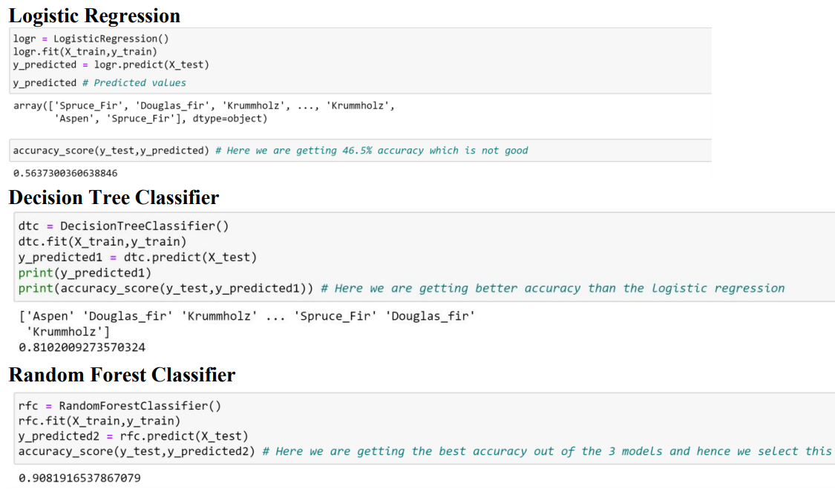
RESULTS
Distribution of Features: Visualization of numerical data distribution.
Scaling of Dataset: Importance of scaling for model stability.
Violin Plots: Insights into forest cover type distribution.
Balancing of Dataset: Use of SMOTE to address class imbalance.
Accuracy of Models: Comparison of Logistic Regression, Decision Tree, and Random Forest.
Model Export: Confirmation of model readiness for future predictions.
Visuals: Include relevant graphs and charts to illustrate results.
Random Forest Classifier achieved 90.81% accuracy.
Decision Tree Classifier achieved 81.02% accuracy.
Logistic Regression achieved 56.37% accuracy.

